Slide 1

COMP24111 lecture 3
The Linear Classifier,
also known as the “Perceptron”

Slide 2
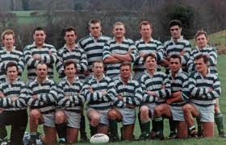
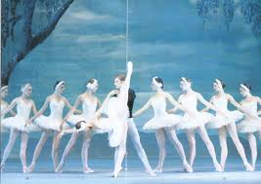
LAST WEEK: our first “machine learning” algorithm
The K-Nearest Neighbour Classifier
Testing point x
For each training datapoint x’
measure distance(x,x’)
End
Sort distances
Select K nearest
Assign most common class
Make your own notes on its advantages / disadvantages.
I’ll ask for volunteers next time we meet…..

Slide 3
Supervised Learning Pipeline for Nearest Neighbour
Training data
Learning algorithm
(do nothing)
Testing Data
(no labels)
Model
(memorize the training data)
Predicted Labels

Slide 4
The most important concept in Machine Learning

Slide 5
The most important concept in Machine Learning
Looks good so far…

Slide 6
The most important concept in Machine Learning
Looks good so far…
Oh no! Mistakes!
What happened?

Slide 7
The most important concept in Machine Learning
Looks good so far…
Oh no! Mistakes!
What happened?
We didn’t have all the data.
We can never assume that we do.
This is called “OVER-FITTING”
to the small dataset.

Slide 8
COMP24111 lecture 3
The Linear Classifier

Slide 9
Supervised Learning Pipeline for Linear Classifiers
Training data
Learning algorithm
(search for good parameters)
Testing Data
(no labels)
Model
(equation)
Predicted Labels

Slide 10

A more simple, compact model?
height
weight

Slide 11
What’s an algorithm to find a good threshold?
t=40
while ( numMistakes != 0 )
{
t = t + 1
numMistakes = testRule(t)
}
height
weight

Slide 12
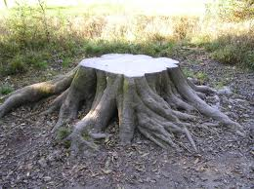
We have our second Machine Learning procedure.
The threshold classifier (also known as a “Decision Stump”)
t=40
while ( numMistakes != 0 )
{
t = t + 1
numMistakes = testRule(t)
}

Slide 13
Three “ingredients” of a Machine Learning procedure
The final product, the thing you have to package up and send to a customer. A piece of code with some parameters that need to be set.
“Model”
The performance criterion: the function you use to judge how well the parameters of the model are set.
“Error function”
“Learning algorithm”
The algorithm that optimises the model parameters, using the error function to judge how well it is doing.

Slide 14
Three “ingredients” of a Threshold Classifier
Error function
t=40
while ( numMistakes != 0 )
{
t = t + 1
numMistakes = testRule(t)
}
Learning algorithm
Model
General case – we’re not just talking about the weight
of a rugby player – a threshold can be put on any feature ‘x’.

Slide 15
Supervised Learning Pipeline for Threshold Classifier
Training data
Learning algorithm
(search for good threshold t)
Testing Data
(no labels)
Model
(if (x>t)… then …
Predicted Labels

Slide 16
Supervised Learning Pipeline for Nearest Neighbour
Training data
Learning algorithm
(do nothing)
Testing Data
(no labels)
Model
(memorize the training data)
Predicted Labels

Slide 17
What’s the “model” for the Nearest Neighbour classifier?
For the k-nn, the model is the training data itself !
- very good accuracy ☺
- very computationally intensive! ☹
height
Testing point x
For each training datapoint x’
measure distance(x,x’)
End
Sort distances
Select K nearest
Assign most common class
weight

Slide 18

New data: what’s an algorithm to find a good threshold?
height
Our model does not match the problem!
weight
1 mistake…

Slide 19
New data: what’s an algorithm to find a good threshold?
☺
height
But our current model cannot represent this…
weight
☹

Slide 20
We need a more sophisticated model…

Slide 22
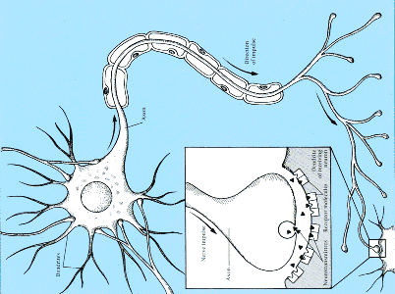
Input signals sent
from other neurons
If enough sufficient signals accumulate, the neuron fires a signal.
Connection strengths determine how the signals are accumulated

Slide 23





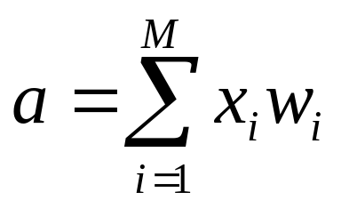








input signals ‘x’ and coefficients ‘w’ are multiplied
weights correspond to connection strengths
signals are added up – if they are enough, FIRE!
output signal
incoming signal
connection strength
activation
level

Slide 24
Calculation…
Sum notation
(just like a loop from 1 to M)
Multiple corresponding elements and add them up
double[] x =
a
(activation)
double[] w =
if (activation > threshold) FIRE !

Slide 25
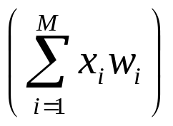

The Perceptron Decision Rule
if

Slide 26
if
output = 0
output = 1
Rugby player = 1
Ballet dancer = 0

Slide 27
Is this a good decision boundary?
if

Slide 28
w₁ = 1.0
w₂ = 0.2
t = 0.05
if

Slide 29
w₁ = 2.1
w₂ = 0.2
t = 0.05
if

Slide 30
w₁ = 1.9
w₂ = 0.02
t = 0.05
if

Slide 31
w₁ = -0.8
w₂ = 0.03
t = 0.05
Changing the weights/threshold makes the decision boundary move.
Pointless / impossible to do it by hand – only ok for simple 2-D case.
We need an algorithm….

Slide 32
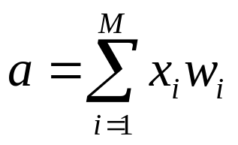
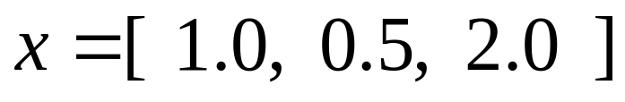
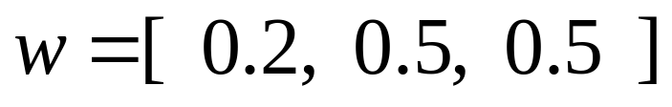
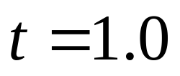
x1
x2
x3
w1
w2
w3
Q1. What is the activation, a, of the neuron?
Q2. Does the neuron fire?
Q3. What if we set threshold at 0.5 and weight #3 to zero?
Take a 20 minute break and think about this.

Slide 33
20 minute break

Slide 34
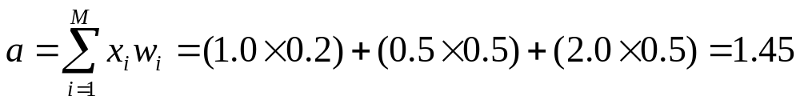
x1
x2
x3
x1
x2
x3
w1
w2
w3
w1
w2
w3
Q1. What is the activation, a, of the neuron?
Q2. Does the neuron fire?
if (activation > threshold) output=1 else output=0
…. So yes, it fires.

Slide 35
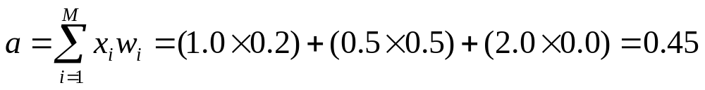
x1
x2
x3
x1
x2
x3
w1
w2
w3
w1
w2
w3
Q3. What if we set threshold at 0.5 and weight #3 to zero?
if (activation > threshold) output=1 else output=0
…. So no, it does not fire..

Slide 36
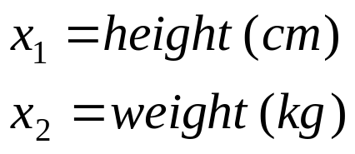

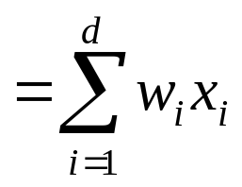
We need a more sophisticated model…
The Perceptron
height
weight

Slide 37




The Perceptron
Decision boundary
height
height
weight
weight
, and change the position of the DECISION BOUNDARY

Slide 38
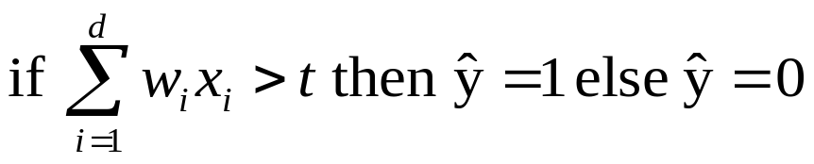
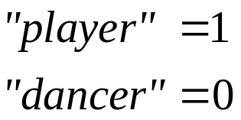
The Perceptron
Model
Error function
Learning algo.
height
weight

Slide 39

Perceptron Learning Rule
new weight = old weight + 0.1 ( trueLabel – output ) input
update
What weight updates do these cases produce?
if… ( target = 0, output = 0 ) …. then update = ?
if… ( target = 0, output = 1 ) …. then update = ?
if… ( target = 1, output = 0 ) …. then update = ?
if… ( target = 1, output = 1 ) …. then update = ?

Slide 40
Learning algorithm for the Perceptron
initialise weights to random numbers in range -1 to +1
for n = 1 to NUM_ITERATIONS
for each training example (x,y)
calculate activation
for each weight
update weight by learning rule
end
end
end
Perceptron convergence theorem:
If the data is linearly separable, then application of the Perceptron learning rule will find a separating decision boundary, within a finite number of iterations

Slide 41
Supervised Learning Pipeline for Perceptron
Training data
Learning algorithm
(search for good parameters)
Testing Data
(no labels)
Model
(if… then…)
Predicted Labels

Slide 42
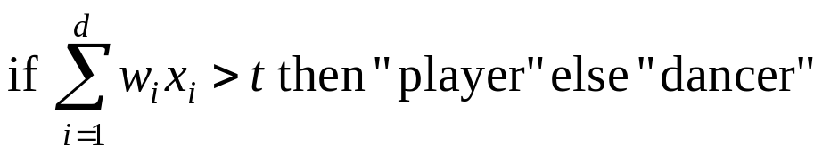
New data…. “non-linearly separable”
height
Our model does not match the problem!
(AGAIN!)
weight
Many mistakes!

Slide 43
Multilayer Perceptron
x1
x2
x3
x4
x5

Slide 44
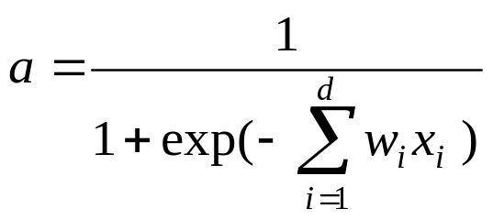
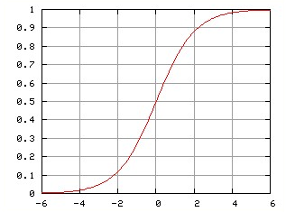

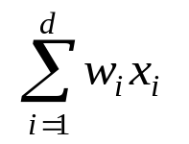
Sigmoid activation – no more thresholds needed ☺

Slide 45
MLP decision boundary – nonlinear problems, solved!
height
weight

Slide 46
Neural Networks - summary
Perceptrons are a (simple) emulation of a neuron.
Layering perceptrons gives you… a multilayer perceptron.
An MLP is one type of neural network – there are others.
An MLP with sigmoid activation functions can solve highly nonlinear problems.
Downside – we cannot use the simple perceptron learning algorithm.
Instead we have the “backpropagation” algorithm.
This is outside the scope of this introductory course.

